Slide 2
Convention Team
Convention Manager Allison Thompson iccmanager@harmonyinc.org
Contest/Stage Manager Linda Hilko ICCContestManager@harmonyinc.org
Onsite Manager Marie Ross ICCOnsiteManager@harmonyinc.org
Registration Manager Linda Briggs ICCRegistrar@harmonyinc.org
Assistant Margaret Cain ICCTeamAssistant@harmonyinc.org
Volunteer Manager Anne Leinen ICCVolunteerManager@harmonyinc.org
Marketing Manager Shannon Shelton-Muller ICCMarketingMgr@harmonyinc.org
Project Manager Rita Sherman ICCProjectMgr@harmonyinc.org
Business Services Manager Deborah Wilson ICCBusinessMgr@harmonyinc.org

Slide 3
Agenda
Logistics
Contestant Information
Attendee Information
Activities
Volunteering
Q&A

Slide 4
Logistics

Slide 5
DEADLINES
September 1
End of early bird AEP pricing
Last day for contest entry ($5 per performer late fee applies)
September 11
Live Draw for order of appearance
September 30
Dinner Registrations
October 1
Big Screen Ads
October 13
Hotel Room Reservations
November 3
Online Registration (you may still purchase AEPs and tickets at the door)

Slide 6
IC&C Agenda Overview
Friday, November 10 9:00 am – Chorus Contest 8:30 pm – Parade of Champions
Saturday, November 11 9:00 am – Education Classes 11:30 am – Quartet Finals 6:00 pm – Dinner 8:30 pm – Showcase of Champions
Wednesday, November 8 2:00 pm - Registration opens 5:00 pm – Contestant Stage Viewing 7:30 pm - Opening Ceremonies 9:00 pm – Welcome Reception & Singing with the Queens
Thursday, November 9 8:30 am – Education classes 11:00 am - Quartet Semi Finals
All times are subject to change

Slide 7
Conference App
Everything you need to know will be at your fingertips!
Access the full agenda and chat with other attendees.
Instructions on how to download and use the app will be sent out prior to IC&C.
Programs also will be made available in advance to print or view online in addition to daily Harmony Highlights sheet with contestant info.

Slide 8
Travel
The closest airport is Gerald R. Ford (GRR) in Grand Rapids.
If you are driving, click here for directions to the hotel.
All attendees will receive a 50% discount off advertised parking rates during the convention.
Complimentary airport transportation from the airport to the hotel is available on the dates and times below.
Arrivals: Wednesday, November 8th 10:00 AM – 8:00 PM
Departures: Sunday, November 12th 4:00 AM – 2:00 PM
If you are traveling outside of the dates and times that the shuttle is running, click here to see ground transportation options available from the airport.
Notes:
transportation will be by full-size motorcoach departing from the airport every hour, to take the shuttle please exit through door #3 (across from Baggage Claim). Return trips will depart from the Amway Grand Plaza, Lyon Street entrance on the hour.

Slide 9
Hotel Reservations
Single, Double, Triple, Quad: $164 + 15% tax
All prices are listed in US Dollars. Payment is due in US Dollars or the Canadian Equivalent.
Reservations must be accompanied by a valid major credit card.
Deposits are refundable if cancellation is received at least 48 hours prior to the arrival date.
Check-in is 4:00 PM ET. Check-out time is 11:00 AM ET.
There is a $50 early departure fee if you leave prior to your scheduled departure date.
Members are required to stay at the convention hotel or pay the Fair Share Assessment Fee: one night’s stay.
Reservation deadline is October, 13, 2023.
https://www.experiencegr.com/harmony-inc/

Slide 10
AEP Purchase
We ask that all choruses register their members at the same time versus having members register individually.
Registration is done online and you will register for the Saturday night dinner at the same time
Payment can be mailed, or made through PayPal, or for payment in Canada, by E-Transfer through your Bank.
All prices are in US funds but may be paid in Canadian equivalent with exchange calculated on the day of payment.
Register before Sept 1, to enjoy the below discounted pricing. After Sept. 1 all prices will increase by $10.
Adult Performing Member AEP = $165
Adult Non-Performing Member AEP = $125
Adult Non-Member AEP = $135
Youth Performing Member AEP = $95 Covered by Harmony, Inc.
Youth Non-performing Member AEP = $95 Covered by Harmony, Inc.
Youth Non-Member AEP = $95
Single Event Tickets = $35
Single Event Youth/Child Ticket = $20

Slide 11
Scooter Rental
Discounted rate of $190
Delivery = Tuesday, 11/7
Pick-up = Monday, 11/13
Amigo Mobility Center
616-361-7559
Reservation deadline is 10/25/2023

Slide 12
BIG SCREEN ADS
Show support for competitors, coaches etc.
Harmony, Incorporated IC&C Big Screen Ad Contract (harmonyinc.org)
Deadline is Oct 1
Cost
Harmony, Inc. member, quartet, or chapter = $35
Non-Harmony, Inc. barbershop member = $100
Not affiliated with any barbershop organization (outside provider) = $150

Slide 13
Don’t miss a moment of IC&C!
Scan the QR code to sign-up for the live webcast where you can also watch replays of all the performances.

Slide 14
Contestants

Slide 15
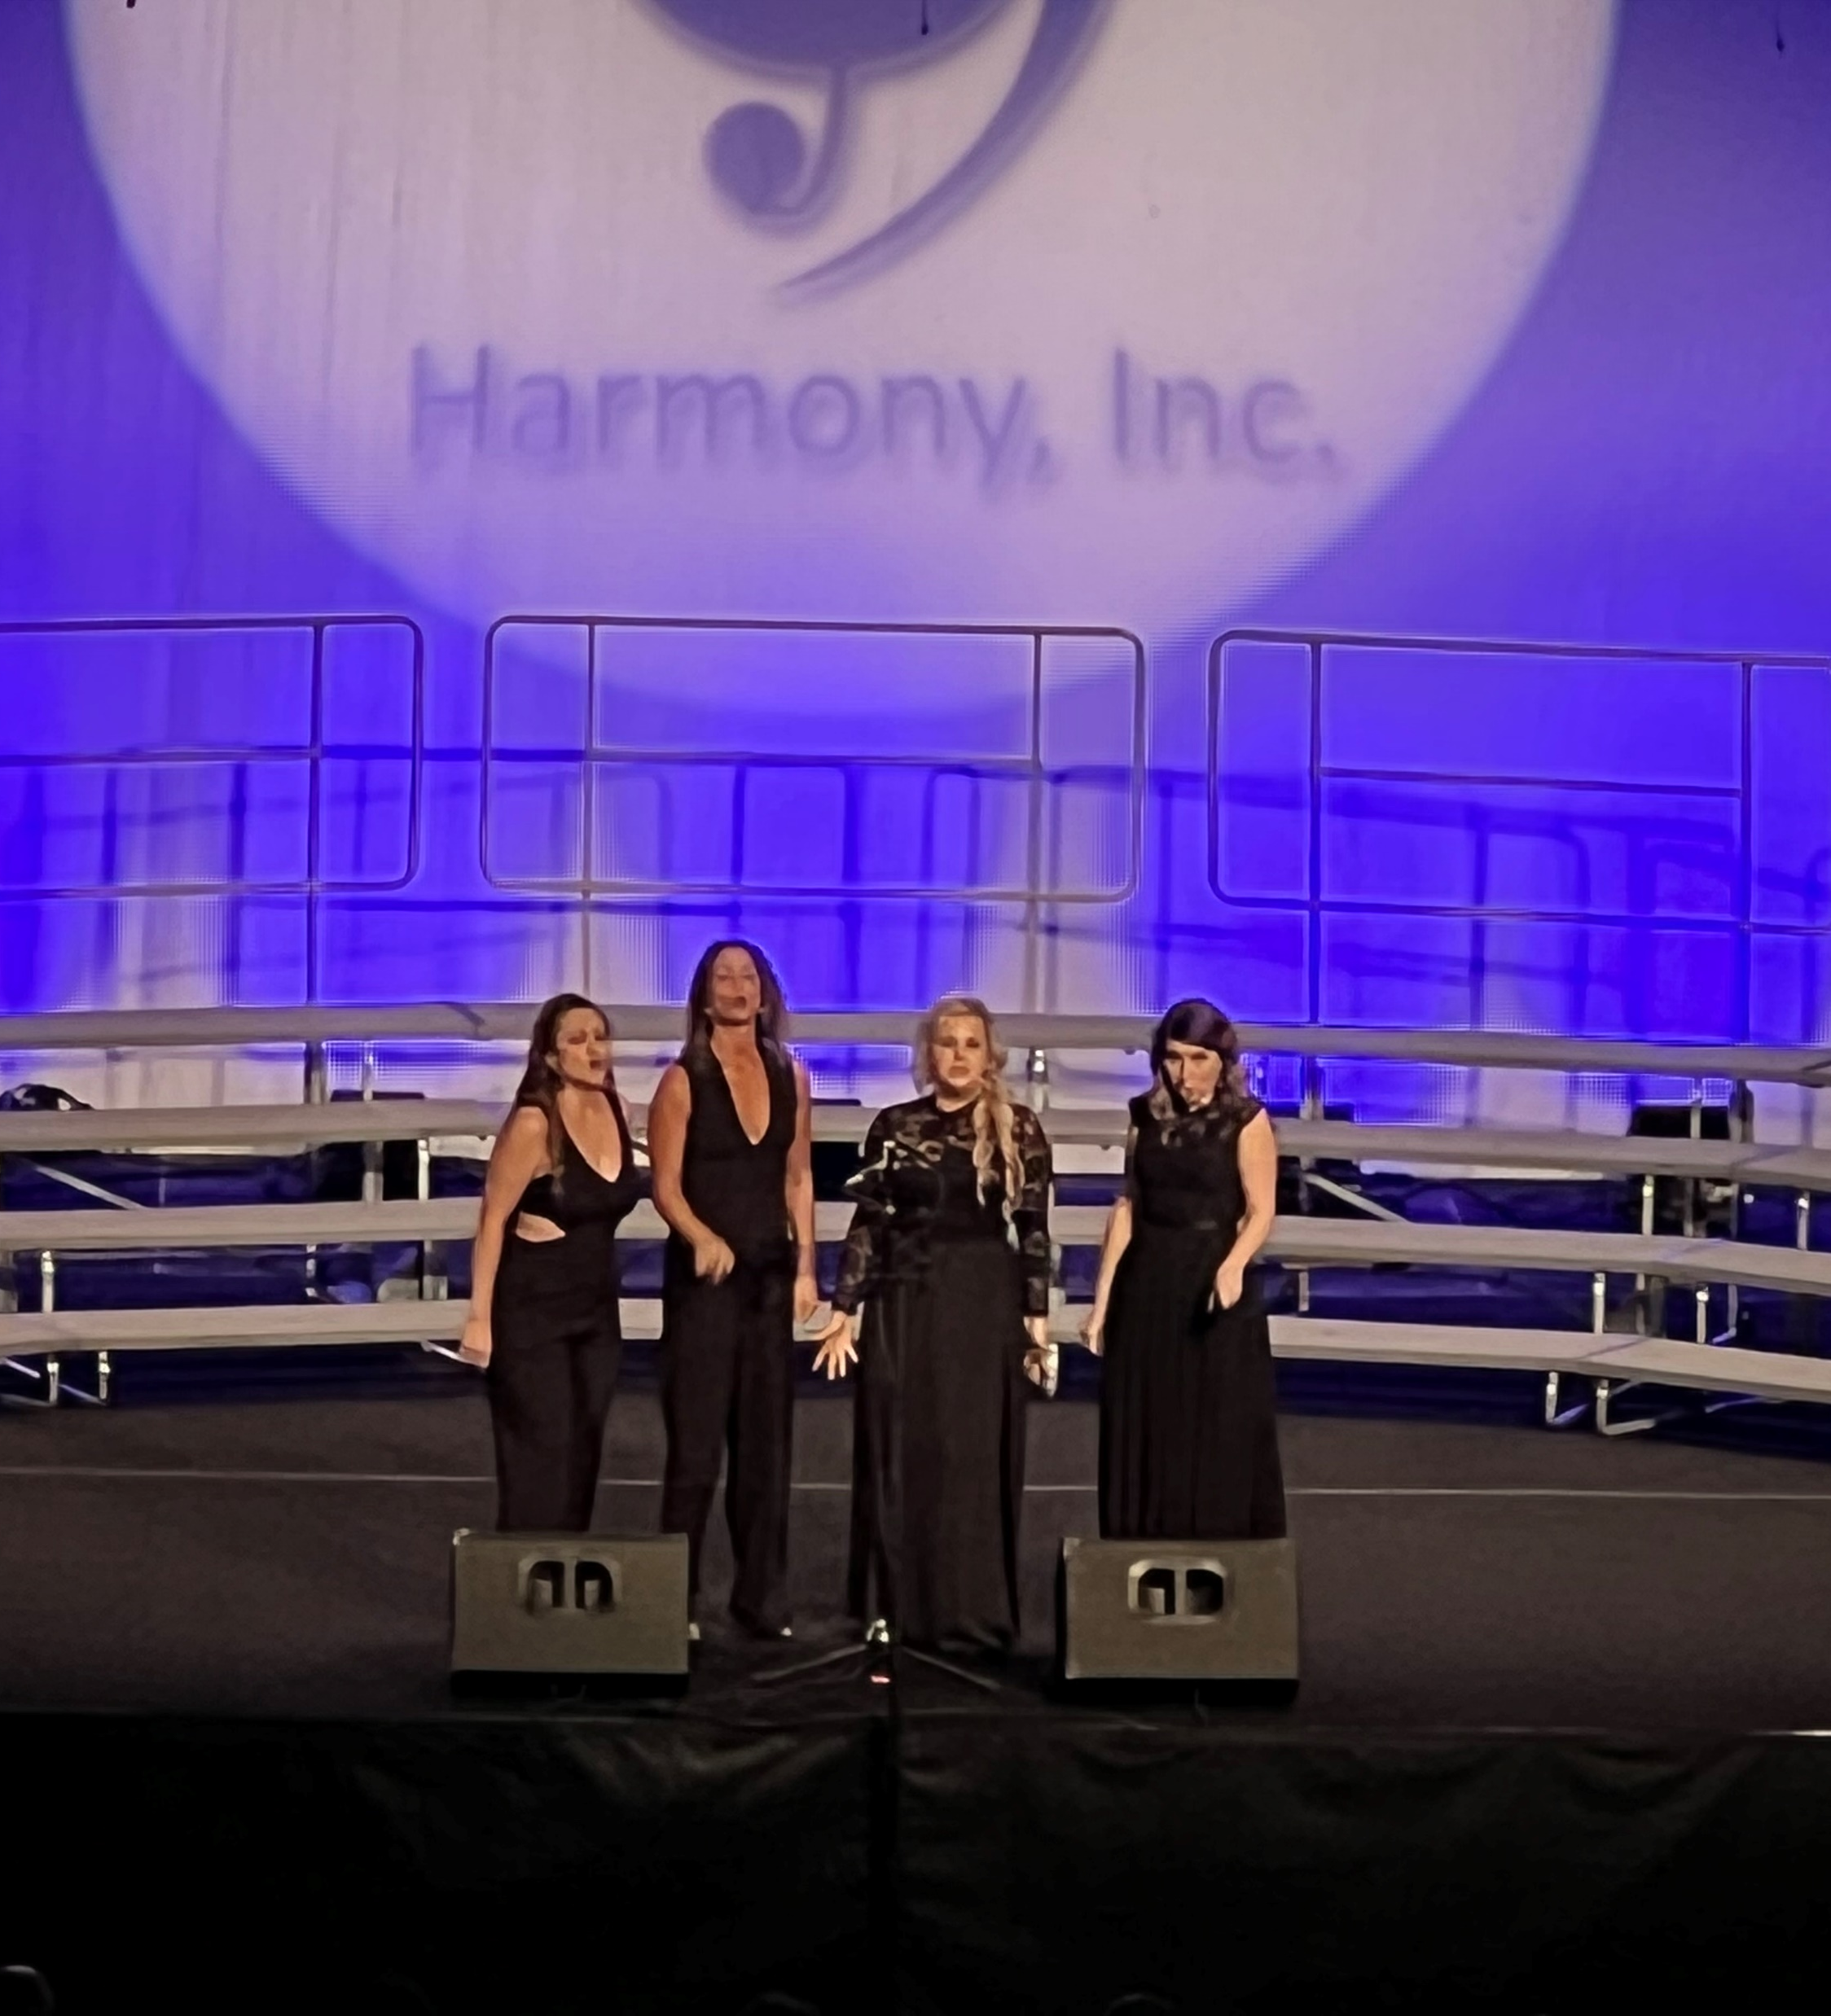
Contestants
Contestants must submit a song registration form two weeks prior to contest (October 25, 2023).
A live drawing for the order of appearance will take place September 11.
ICJC will send the contest pattern and related information to each competitor.
We encourage all contestants to not bring your personal belongings with you in the pattern.
Chorus photos will be taken on stage. A member of the chorus will have the option to meet with the photographer to pick their official photo.
Notes:
All contestants must submit a song registration form including a copy of the page that shows the correct title and copyright information for any arrangement to be performed two weeks prior to contest (October 25, 2023).
A live drawing for the order of appearance will take place September 11. Information on how to watch the live drawing will be sent to all membership once the drawing date and time is finalized. After the drawing, the order of appearance will be added to the IC&C webpage.
The International Contes and Judging Chair (ICJC) will send the contest pattern and related information to each competitor after the order of appearance is published and prior to contest.
We encourage all contestants to not bring your personal belongings with you in the pattern, as they will not be allowed backstage. If you must bring something, please make it small, consolidate chorus belongings etc. We will provide a table in a hallway that will be monitored by volunteers. You can drop your belongings on the table before going on stage,and pick them up after you compete.

Slide 16
Panel
We will have one panel judging all of the contests. We will only be printing the Official Scoring Summary for contestants (one per quartet, four per chorus).
Scores will be posted online shortly after each contest as well as posted in the mobile app.
ADM | MUS | PER | SNG
Randy Rensi (PC) | Cary Burns | Joe Hunter | Rob Mance
Rob Arnold | Adam Scott | Mark Kettner | Nate Ogg
 | Rod Sgrignoli | Theresa Weatherbee | John Ward

Slide 17
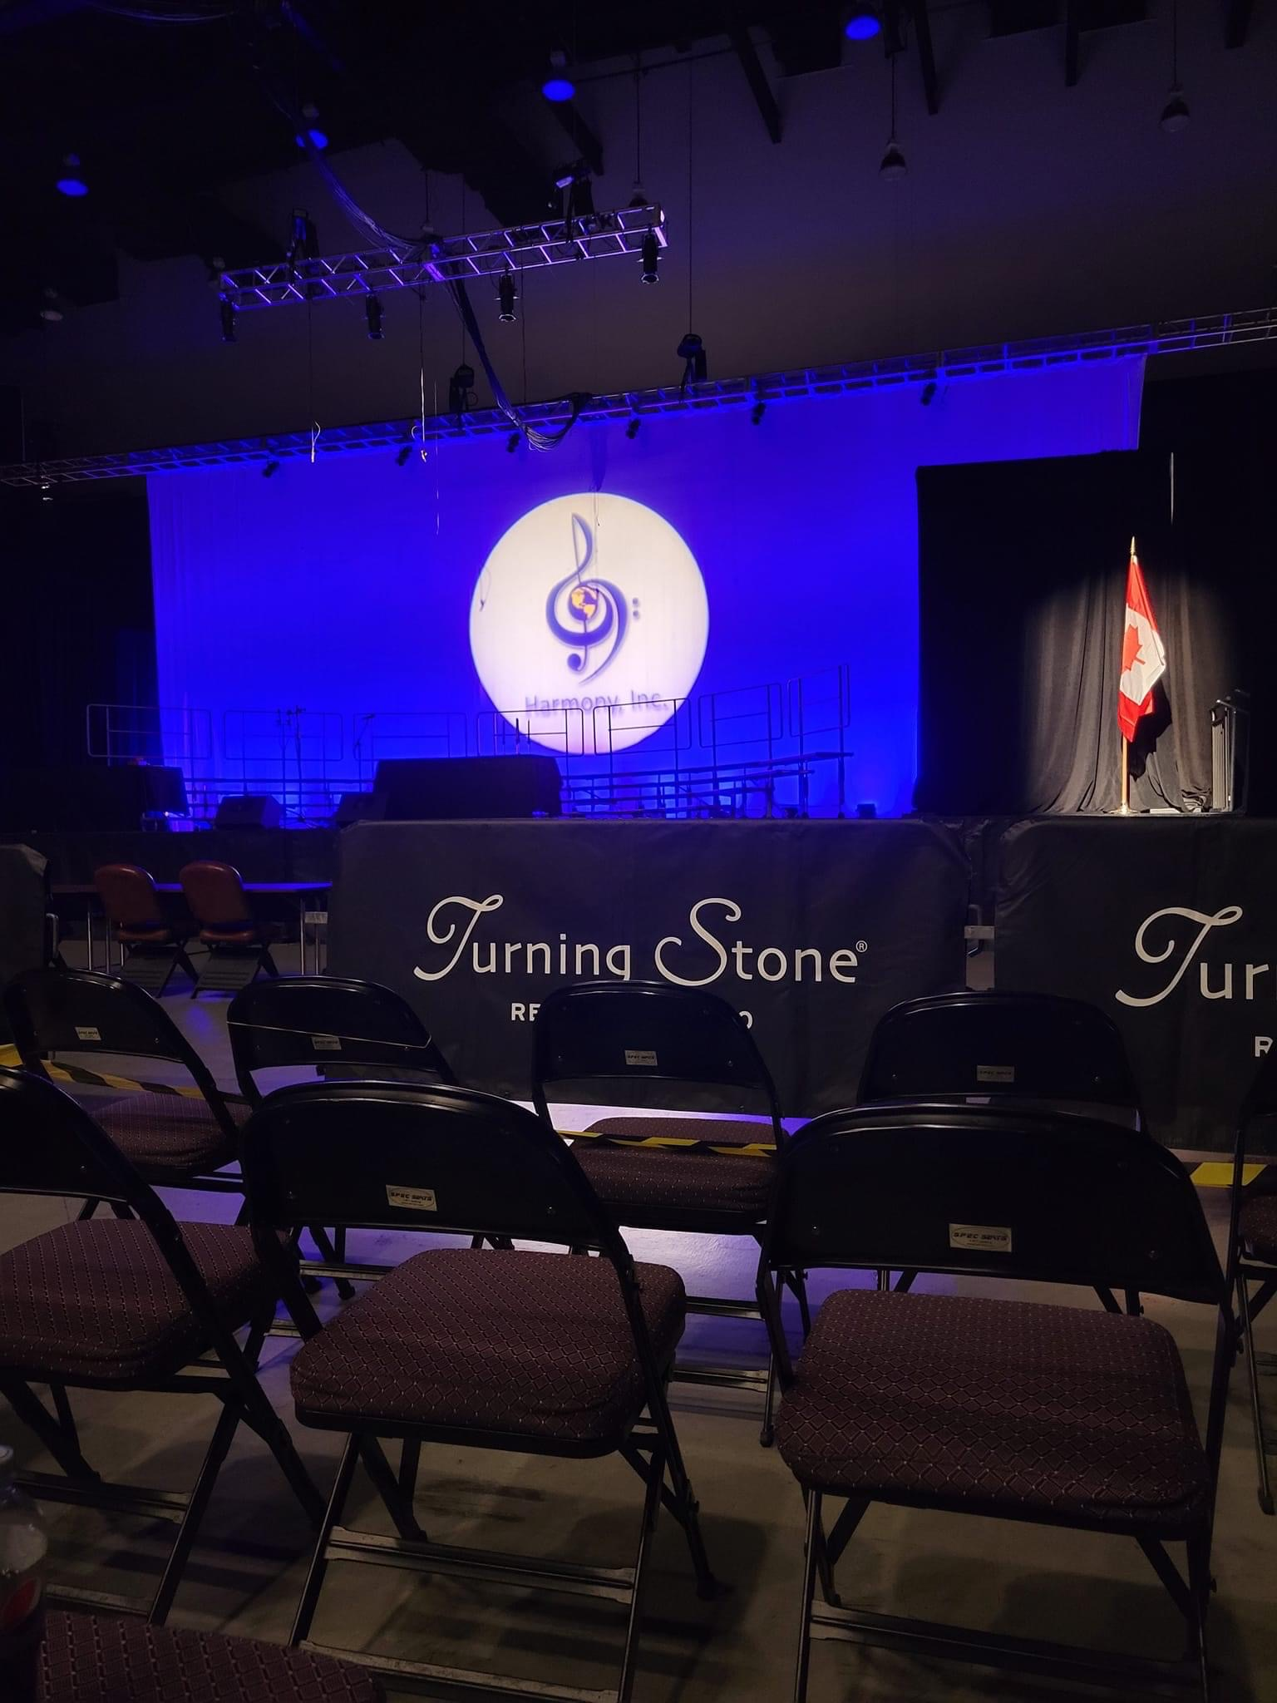
Stage Viewing
Due to the size of our contests, and time constraints, we are not able to allow all choruses and quartets time to practice on the actual stage.
We are able to offer a brief stage “viewing” which will allow up to five people from a chorus and quartets to walk onto the stage.
There is no singing allowed during this time.
Times for the stage viewing will be included in the IC&C schedule, as well as your contestant packets.
The viewing will start with a briefing and Q&A – so be on time!

Slide 18
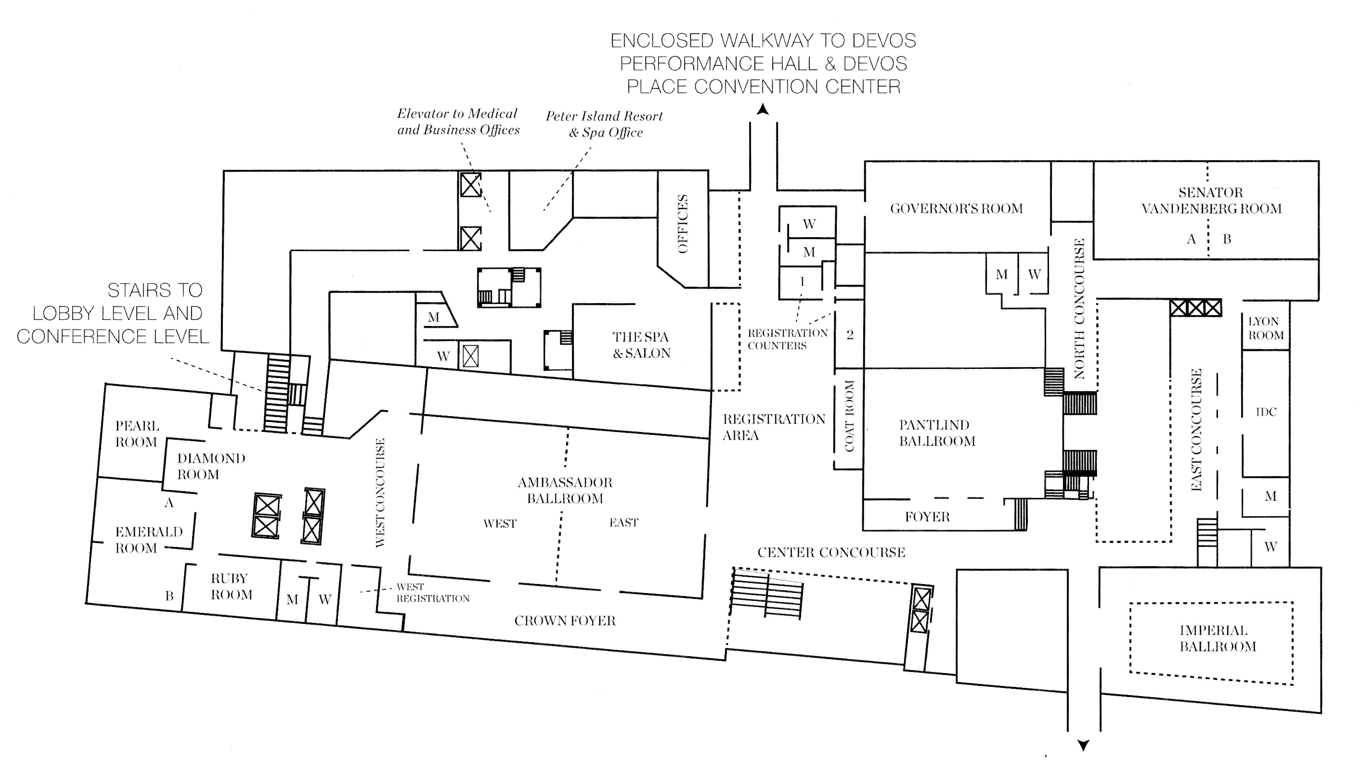
Quartet Pattern HOTEL
Warm Up 1
Warm Up 2
Photos
Meet in the center concourse lobby on the second floor of the hotel to start your pattern

Slide 19
Chorus Pattern HOTEL
Warm Up 1
Warm Up 2
Exit
Exit
Meet in the center concourse lobby on the second floor of the hotel to start your pattern
Chorus photos will be taken on stage.

Slide 20
Pattern Continued DEVOS
STAGE
Celebration Room
Interviews
Fanfare Stage
Entrance from hotel skybridge

Slide 21
Rehearsal Rooms
All choruses will have an opportunity to schedule rehearsal time on Thursday and Friday.
Friday’s time will be pre-assigned based on the order of appearance, and you will be notified of that time via email.
If you are interested in signing up for a time on Thursday, please email the ICCTeamAssistant@harmonyinc.org.

Slide 22
Attendees

Slide 23
Registration
Wednesday
2:00 pm – 7:00 pm
9:00 pm – 10:00 pm
Thursday
8:30 am – 10:00 pm
Friday
7:30 am – 8:30 am

Slide 24
Harmony Mall
Wednesday
2:00 pm – 7:00 pm
9:00 pm – 10:00 pm
Thursday
8:30 am – 10:00 pm
Friday
8:30 am – 10:00 pm
Saturday
8:30 am – 12:00 pm

Slide 25
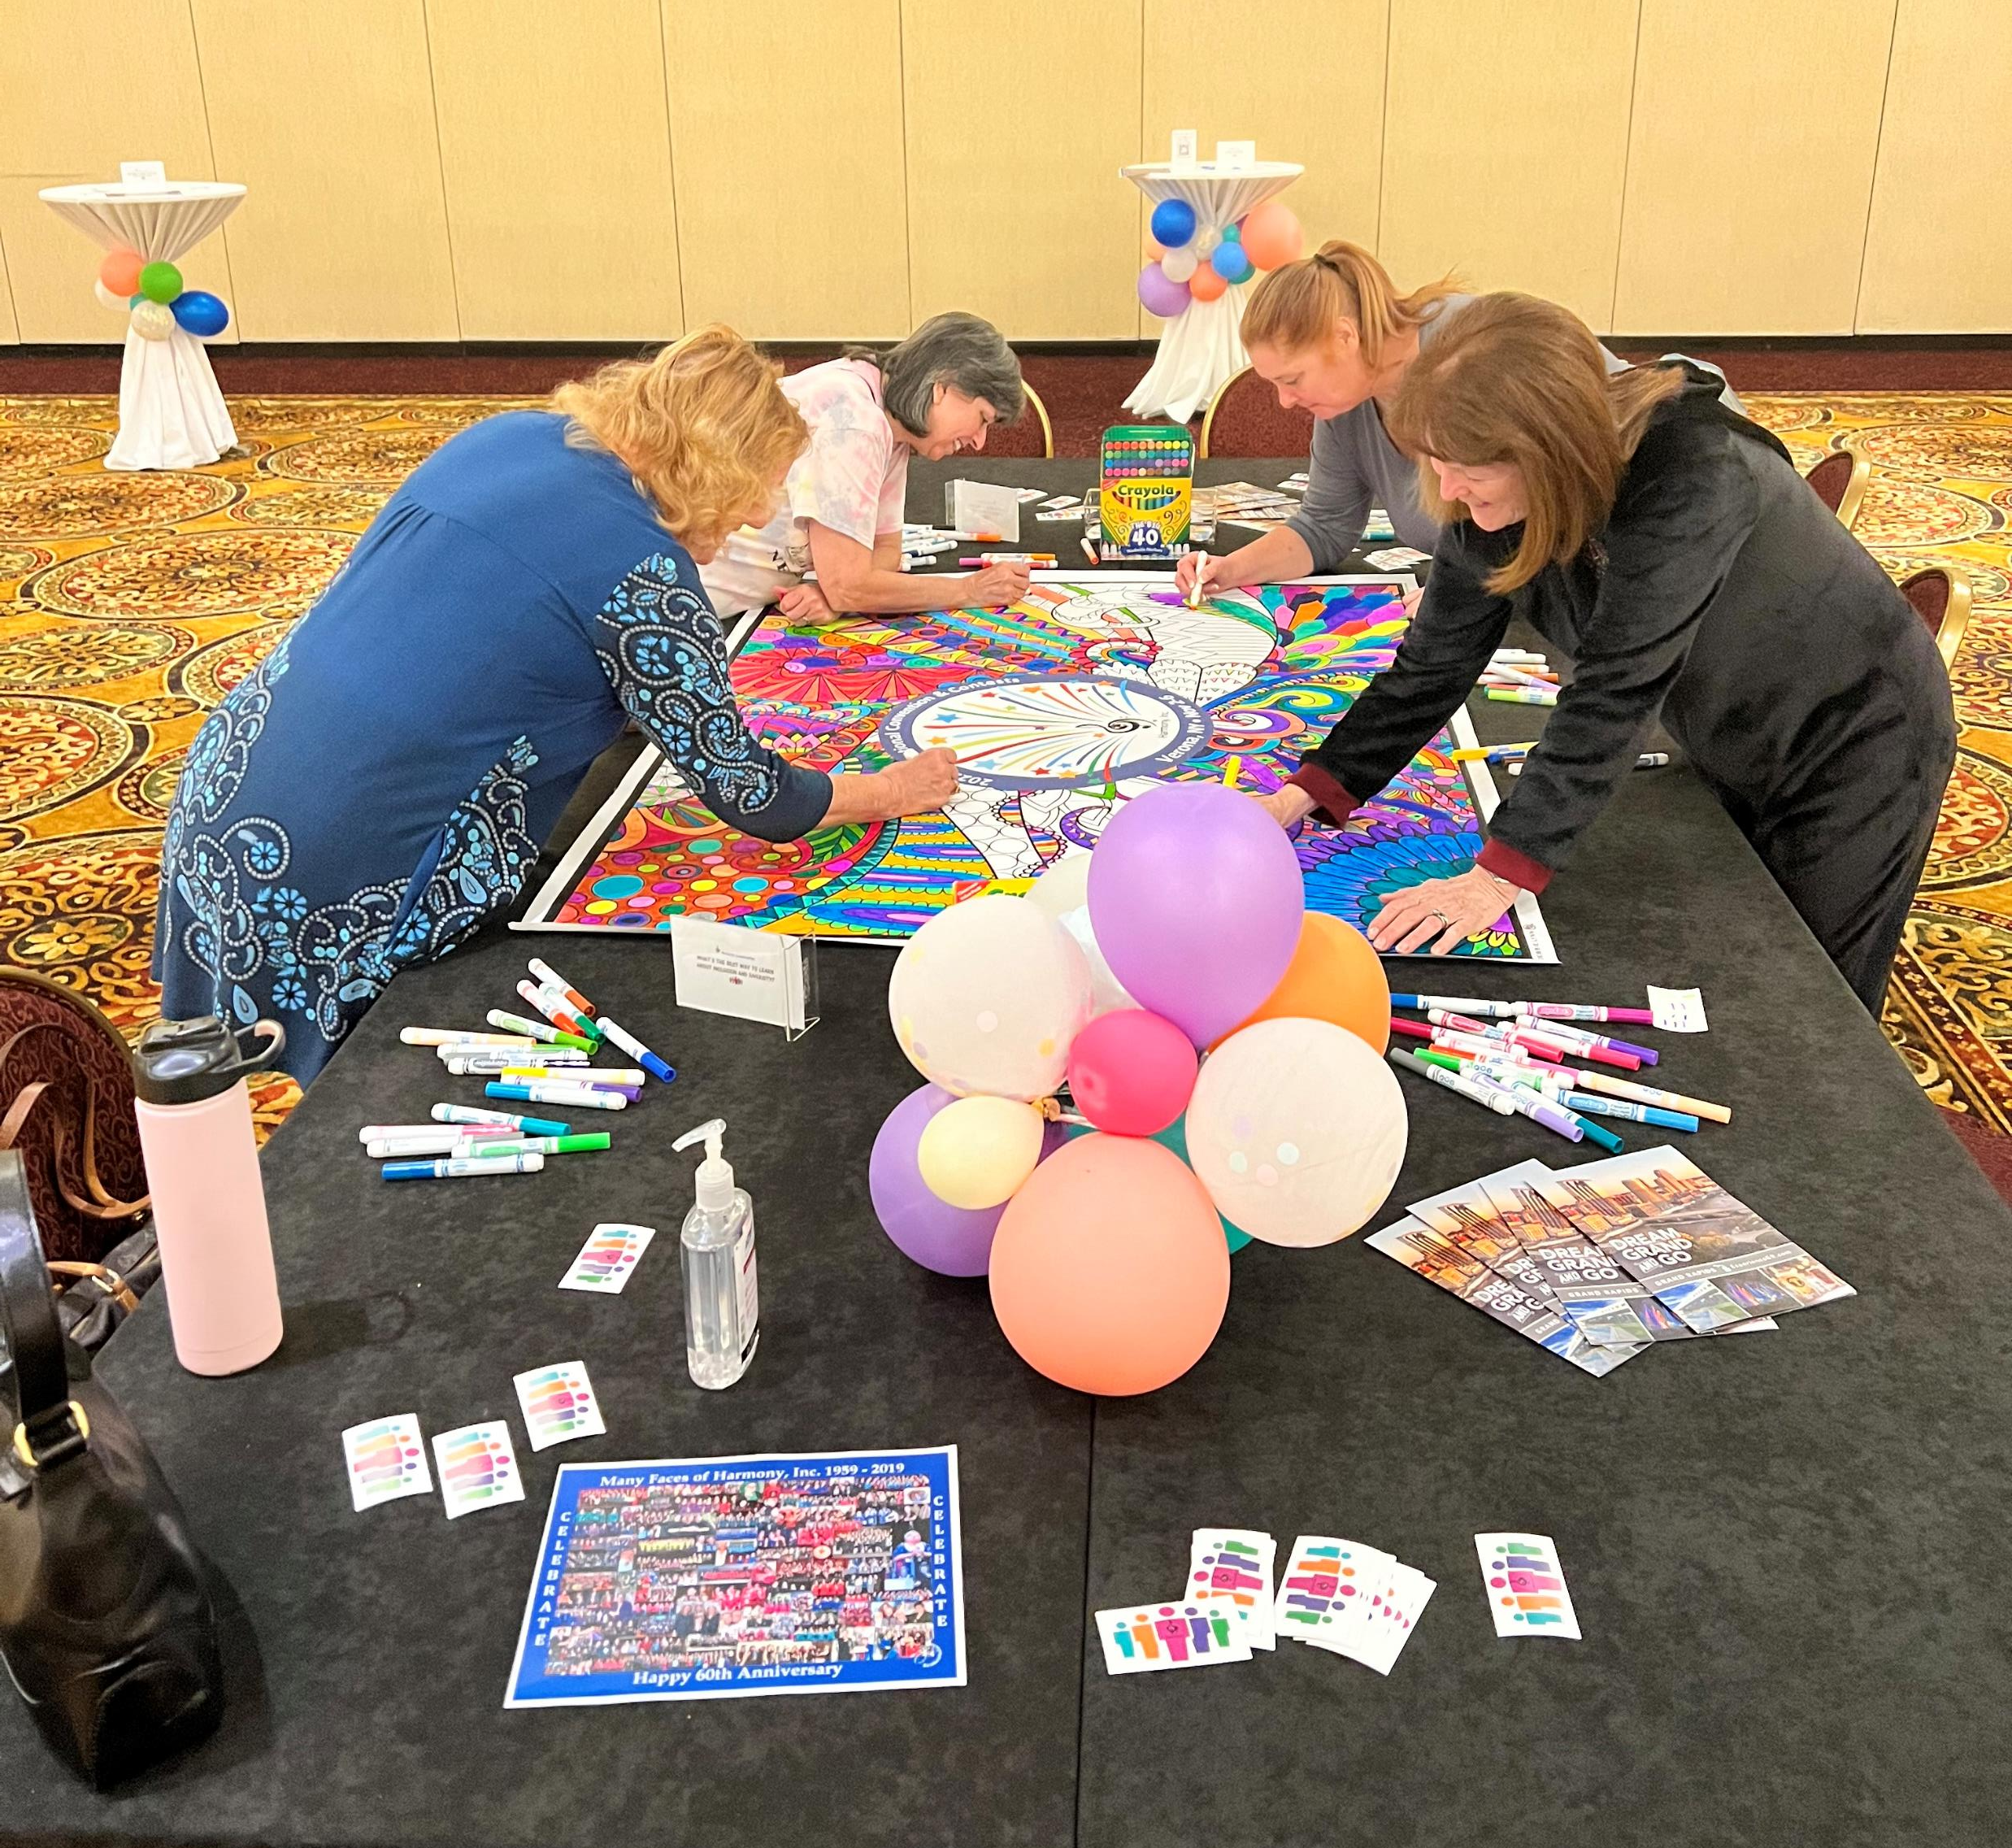
Harmony Hub
Wednesday
2:00 pm – 7:00 pm
9:00 pm – 10:00 pm
Thursday
8:30 am – 10:00 pm
Friday
5:30 pm – 10:00 pm
Saturday
8:30 am – 12:00 pm
An inclusive space for inclusive conversations Sponsored by the Equity and Diversity Committee
Meet friends, make friends, celebrate our diversity

Slide 26
Registration
STAGE
Harmony Hub
Harmony Mall
Entrance from hotel skybridge
Food Sales

Slide 27
Activities

Slide 28
Opening Session
Annual membership meeting
Introduction of the new Board and Assistants
Officer installation
Awards
Special Guest: Grand Rapids Chorus
Raffle
Win a gift card for a FREE Night’s Stay! You MUST BE PRESENT to win.
Welcome Reception
Sing with the Queens

Slide 29
Parade of Champions
You’ll get to hear many of our past Quartet Champions sing some of your favorite songs as well as this year’s champion chorus and Quartet.
The cost to attend this event is included in your AEP. We will have a cash(less) bar available for drink purchases.

Slide 30
Education Classes
Want to be a better singer? Need help getting your chapter off the ground?
IC&C is more than just contests and singing. We are fortunate that our talented members and panel volunteer of their time to help us all become Harmony Stronger.
Be sure to take advantage of this opportunity during IC&C. Classes will be offered on Thursday and Saturday mornings.
Once the classes are finalized, they will be posted on the IC&C page of our website and mobile app.

Slide 31
Saturday Dinner
Dinner buffet is $57.00
Anyone who purchases a dinner ticket will get priority seating at the Showcase
No dinner ticket sales on-site.
All guest tickets can be pre-ordered on the registration form
Table assignments will be sent to choruses and they can determine who sits where
Table assignments will be posted in the app and on the website

Slide 32
Saturday Showcase
All members and guests are invited to the annual showcase event.
It’s a great way to close out IC&C as we recognize and hear from our top medalists.
Anyone attending the dinner will have assigned seating to ensure they get the best seats.
For all others seating will be on a first come, first served basis.

Slide 33
Local Dining
There are food options at the hotel including a Starbucks and Kitchen Counter which serve breakfast.
Click here for the complete list.
During the contest on Thursday and Friday we will offer food sales at the Convention Center.
Additionally, you can check our microsite for a list of local area restaurants; including those that can take large group reservations.
DASH, is a free bus service that provides convenient connections to all parts of the core of downtown Grand Rapids.

Slide 34
Exclusive HI Opportunity
Harmony, Inc. will have access to a select number of tickets for the Tina Turner Musical show.
Includes opportunity to participate in a Talk Back with the cast where you can ask questions!
November 7th – 7:30pm
$59.20 – Mezzanine
$30.00 – Balcony
Deadline is Sept 7
Buy | Broadway Grand Rapids (ticketmaster.com)

Slide 35
Stop by the Center Concourse Show Office on the second floor of the hotel for a quiet place to relax, or to get away from the noise and fast pace of the convention.
Sponsored by the Equity and Diversity Committee

Slide 36
THE SELFIE STATION WILL BE LOCATED IN THE SECCHIA LOBBY

Slide 37
Giving Back to the Community
Bring any of the below (new) items to donate to the local women’s resource center
Shampoo / Conditioner
Razors
Bar soap
Toothpaste
Facewash
Makeup remover wipes
Face moisturizer
Body and hand lotion

Slide 38
Volunteer

Slide 39
Volunteering
Meet new people, see contestants preparing themselves for the stage as they go through the pattern, and get a different perspective on the convention.
Click on the link
Browse through the many volunteer opportunities.
Find a job that interests you and fits with your schedule,

Slide 40
Volunteer Opportunities
Personal Belongings Monitor: Watch over and transport contestants’ belongings while they are performing. You will be backstage and able to see the contestants on the jumbo screen.
Door Monitors: Open and close the doors into the contest hall so the contest flows smoothly and there are no disruptions during a performance. You may take turns sitting inside and outside the contest hall with the other monitors, so you’ll see part of the contest.
Stage Door: Man the doors to/from the stage. You’ll be backstage and able to see the contestants perform on the jumbo screen.
Warm-up Room Monitor: Greet incoming contestants. Keep track of the time allotted to each contestant and give them a 2-minute warning before it’s time to move to the stage.
Seat Counter: After the Opening Ceremony, stick around the ballroom and help the Registration Manager number the VIP seats. You’ll be done in under 30 minutes.
Room Lottery: Distribute room draw lottery tickets to members attending the Opening Ceremonies. Half-hour job.
Showcase Dinner Assistant: Direct members to their tables at the Saturday night banquet. Half-hour job.
Education Classes: Attend an education class, introduce the presenter, and take a head count. Done in an hour and you get to attend an awesome class.

Slide 41
IC&C Resources

Slide 42
Questions

